Slide 1
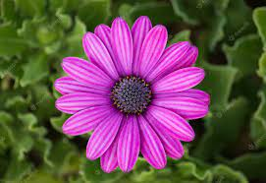
PRETTY WITH A PURPOSE

Slide 2
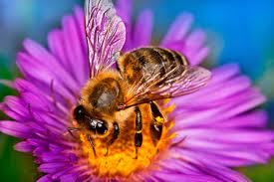
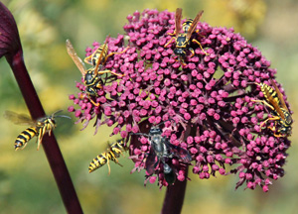
Do you think the flowers wanted the insects to visit them?
Why do insects wanted to visit the flowers?

Slide 3
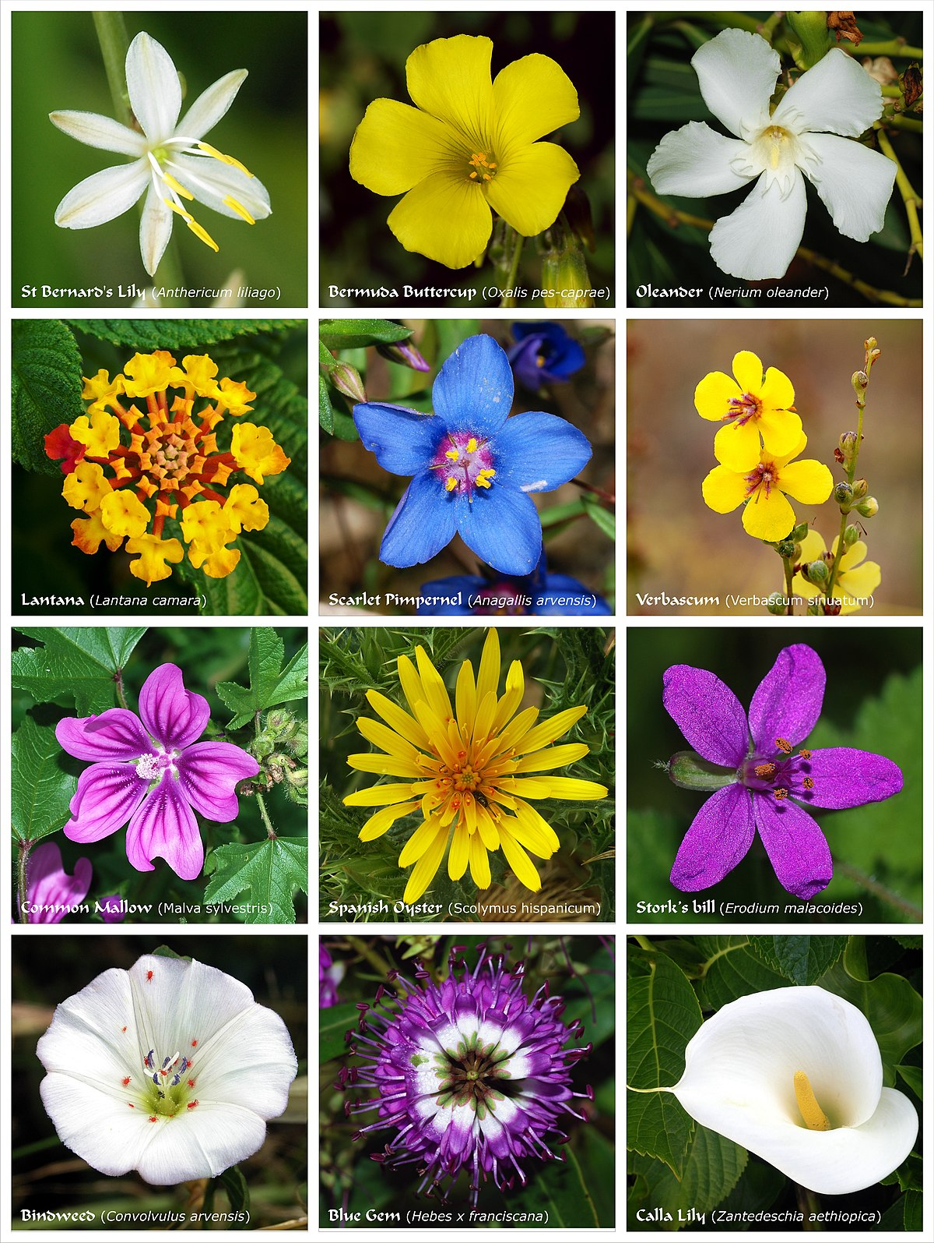
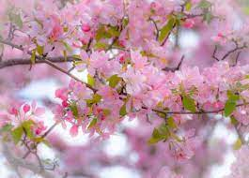
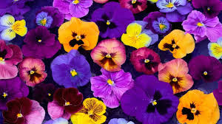

Slide 4
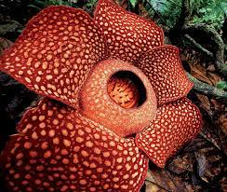
RAFFLESIA – WORLD’S LARGEST FLOWER
The flower with the world’s largest bloom is the Rafflesia arnoldii.
This rare flower is found in the rainforests of Indonesia.
It can grow to be 3 feet across and weigh up to 15 pounds!
It is a parasitic plant, with no visible leaves, roots, or stem.
It attaches itself to a host plant to obtain water and nutrients.
When in bloom, the Rafflesia emits a repulsive odor, similar to that of rotting meat.
This odor attracts insects that pollinate the plant.

Slide 5
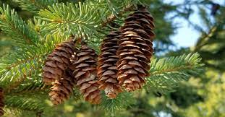
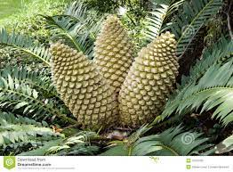
PLANTS THAT DON’T HAVE FLOWERS
Pine Cones
Cycad cone

Slide 6
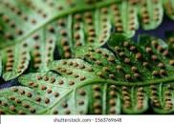
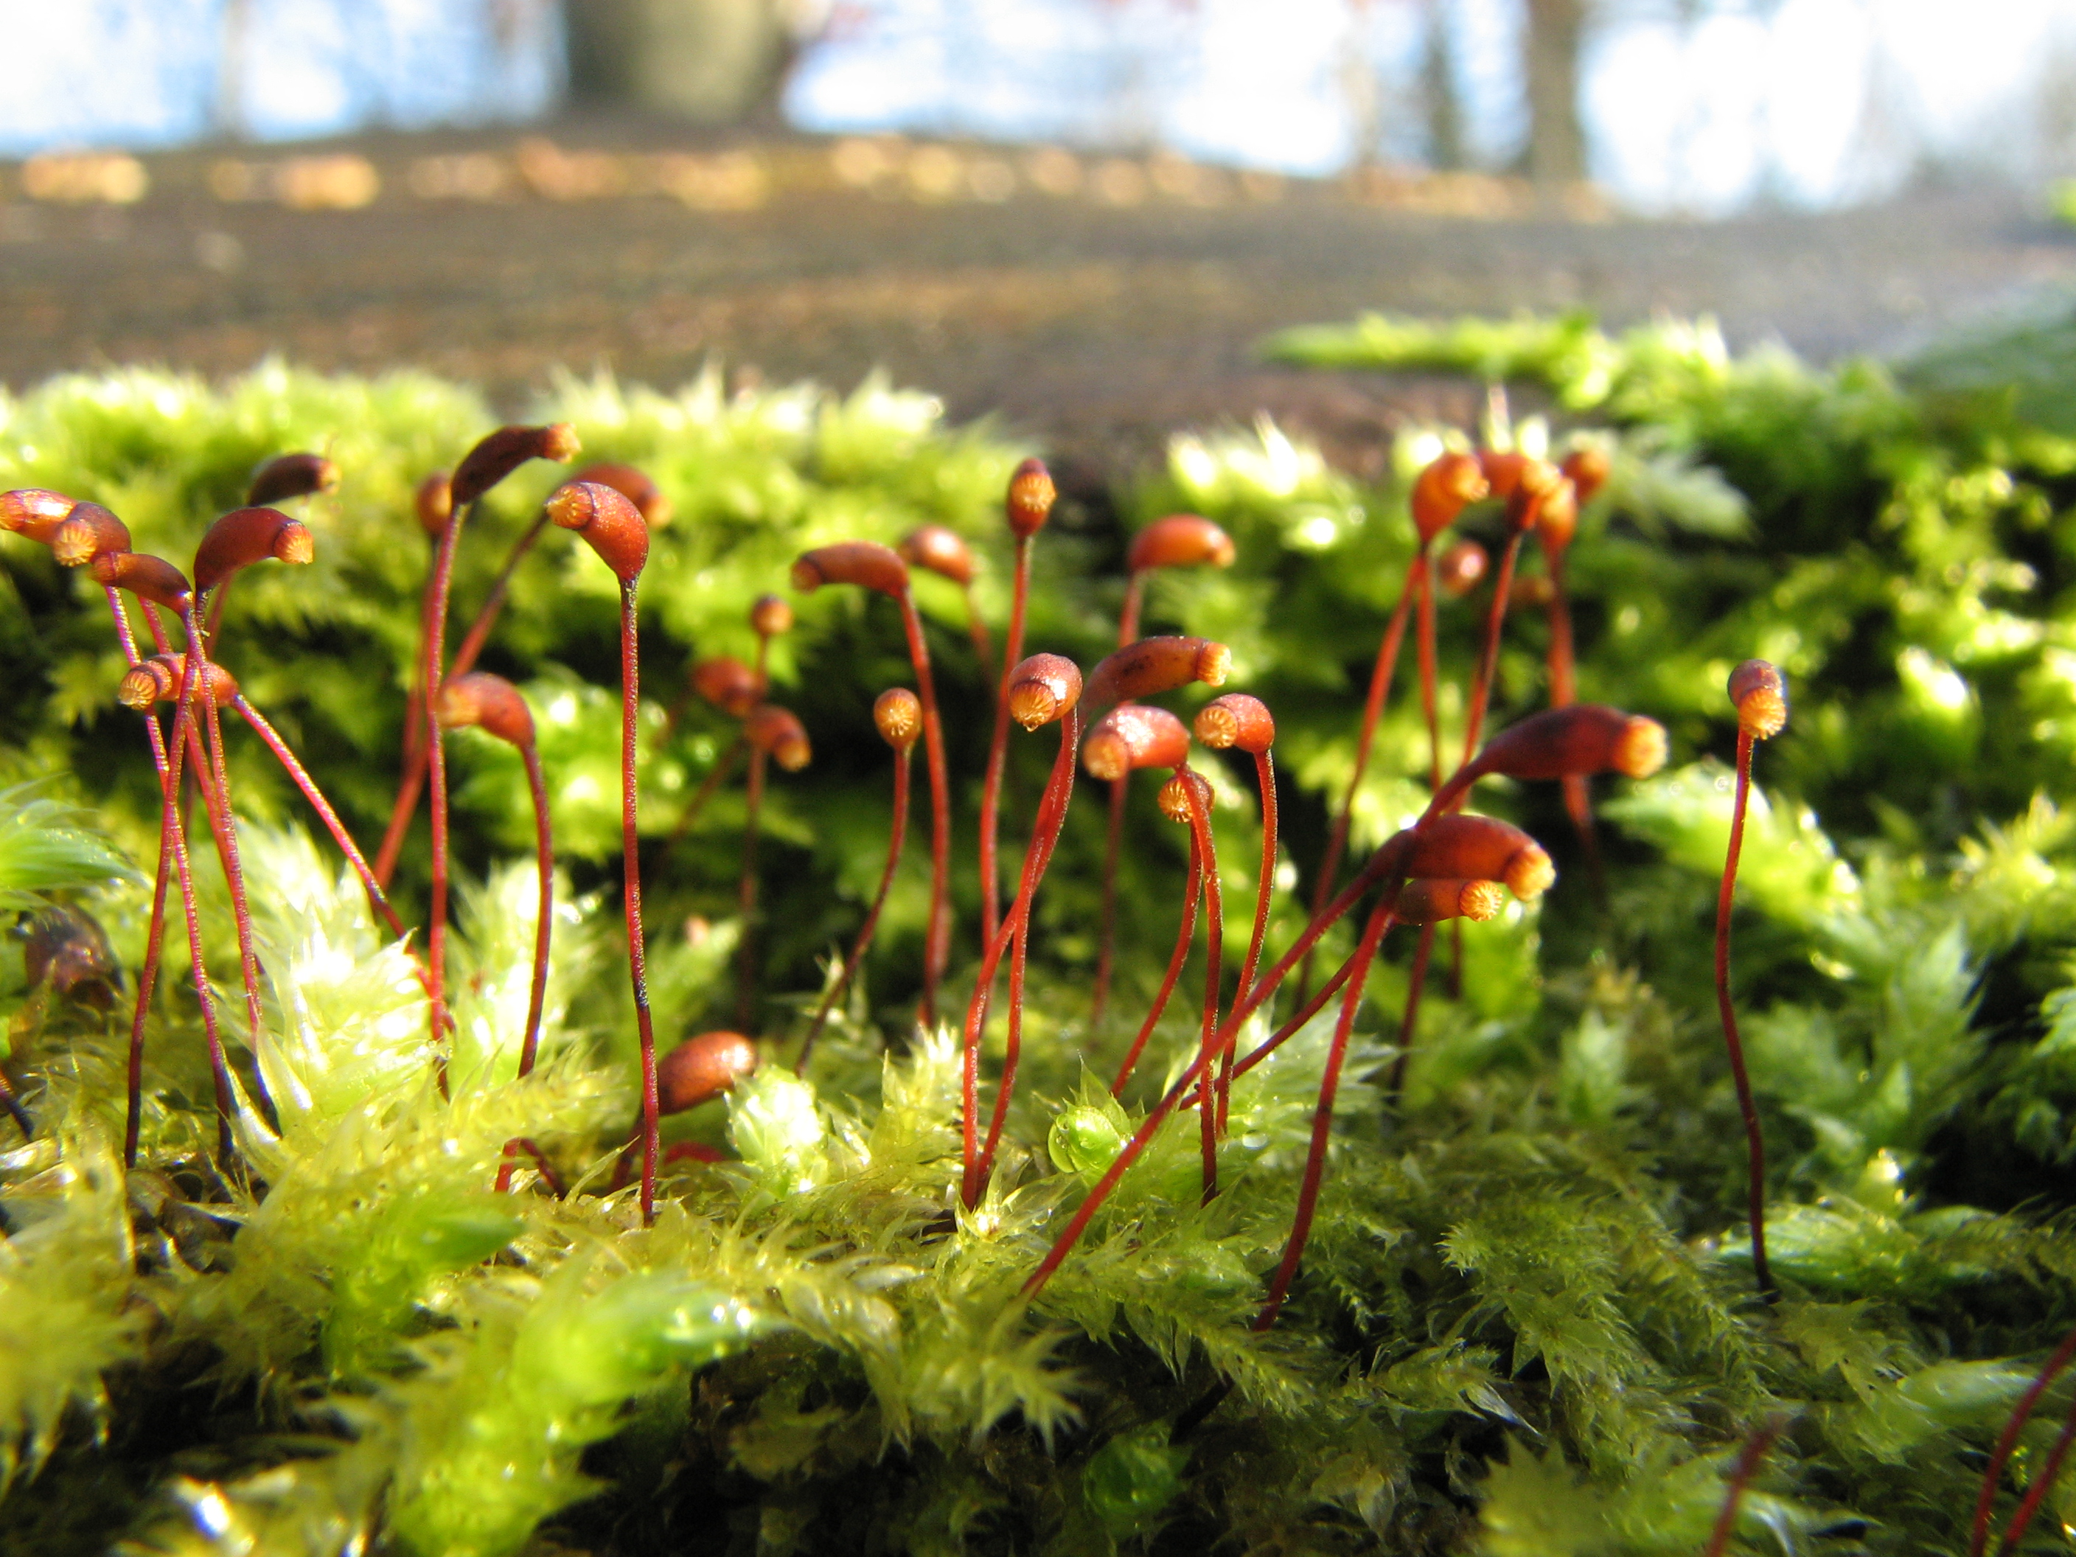
PLANTS THAT DON’T HAVE FLOWERS
Fern with spores
Moss with spore capsules

Slide 7
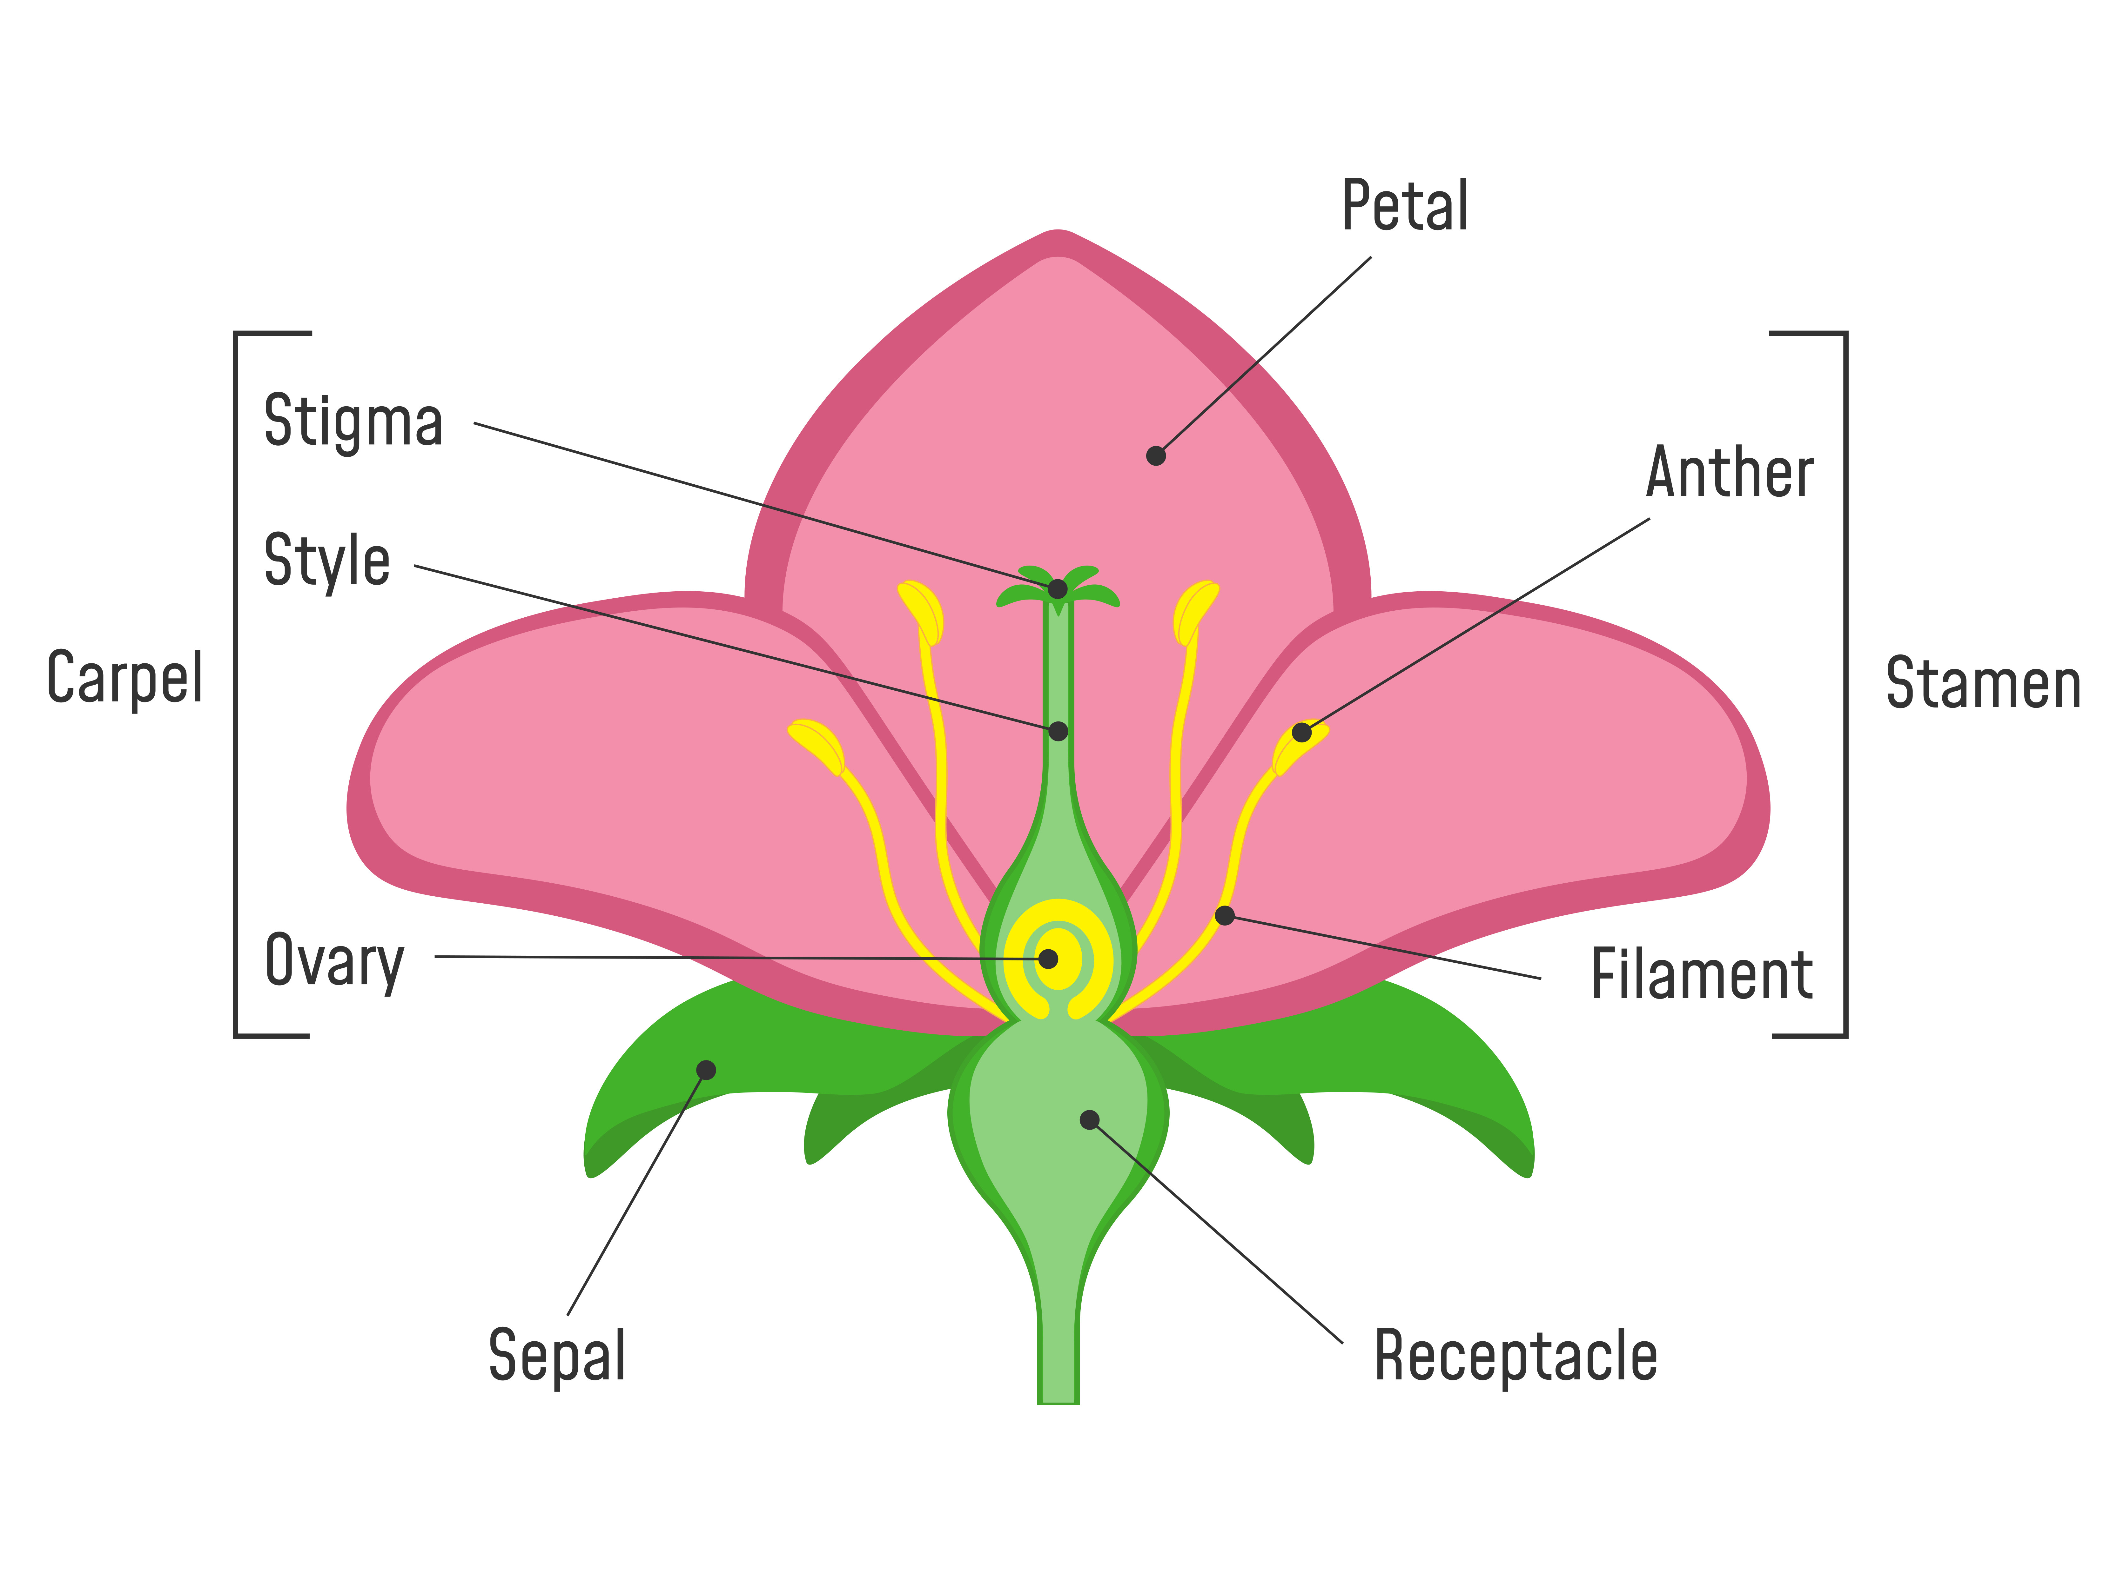
The Reproductive Parts

Slide 8
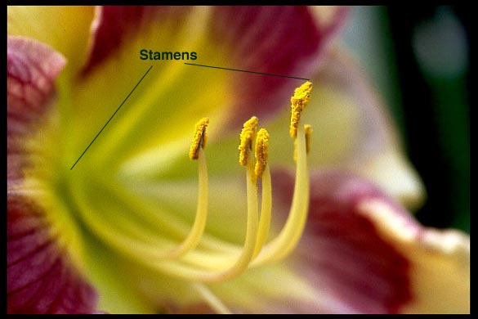
Stamens
The stamens are the male part of the flower.
Found inside the petals.
Make yellow grains called pollen.
Has two parts - Anther and Filament

Slide 9
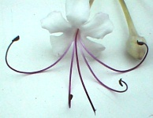
Filament
Stalk that holds up the anther
Connects the anther to the flower

Slide 10
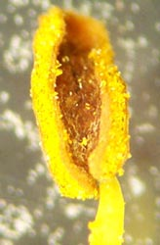
Anther
Part of the stamen
Produces and holds pollen

Slide 11
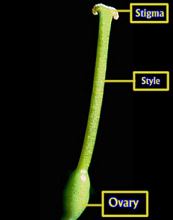
Carpel
The neck of the pistil
Female part of the flower
Usually located in the center

Slide 12
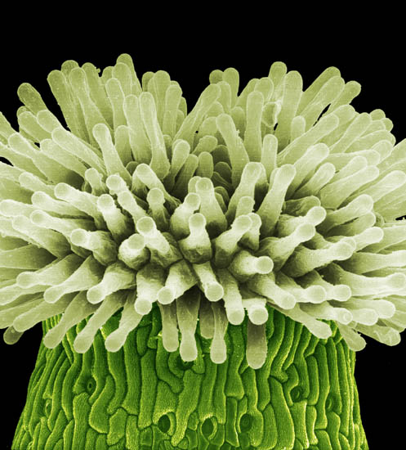
The Stigma
The stigma is the top of the female part of the flower.
Found at the end of the pistil
Pollen from another flower collects on the stigma’s sticky surface.

Slide 13
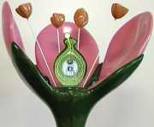
The Ovary
pollen
The ovary protects the ovules.
Pollen travels to the ovules and fertilization takes place.
Now the ovules will develop into seeds.
ovary
ovule

Slide 14
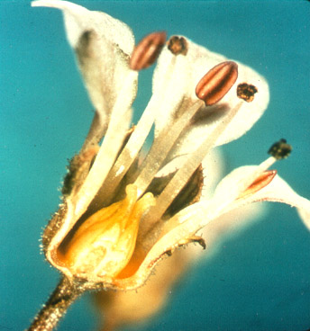
The Ovary
Part of the pistil that contains the ovules

Slide 15
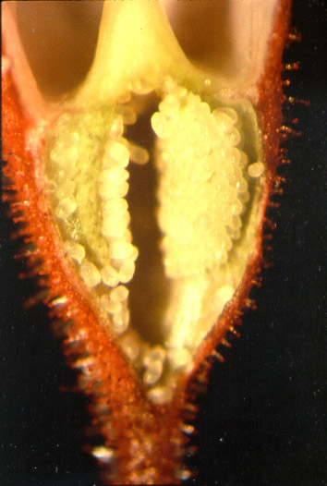
OVULE
The part of the flower in which the eggs are produced and seeds develop

Slide 16
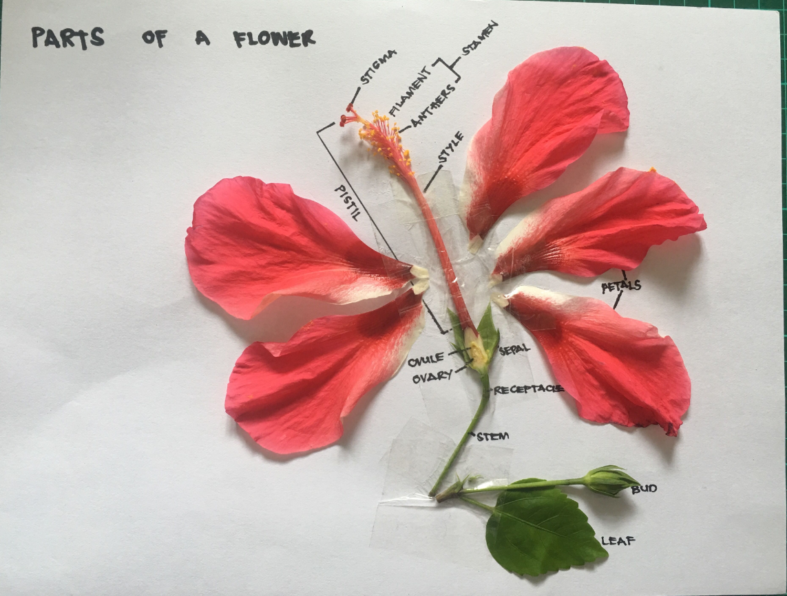

Slide 17
Write the correct words in the boxes:
stamens, stigma, petals, ovary, sepals
1. Pollen sticks to this
2. where the seeds grow
3. these attract insects
4. where the pollen is made
5. These protect the flower before it opens

Slide 18
Write the correct words in the boxes: stamen, stigma, petals, ovary, ovules, pollen, sepals, anther.
7. These attract insects
6. The male part of the flower
8. This is the female part of the flower, which receives the pollen
9. This is where pollen is made
10. Insects carry this from flower to flower
11. These protect the flower before it opens
13. This is where the seeds will grow
12. These become seeds after fertilization

Slide 19
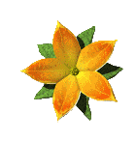
THANK YOU
Pollination
https://youtu.be/J7q9Kn1rhRc

